Slide 1
“Linux for Human Beings”
Ubuntu Operating System Usability Test
Arthur Rahmes, Cody Richardson, Gabriel Venezuela, Sean Wray

Slide 2
Ubuntu is an operating system based on the Linux kernel.
Distributed as free and open source software.
Features a Graphical User Interface (GUI) that allows users to interact with their computer through graphical icons.
Most commonly used for personal desktop and laptop computers.
Also used on servers and for cloud computing.

Slide 3
Pre-Testing Interview Questions
How do you rate your level of computer literacy?
What is your biggest concern in an operating system?
Do you have any experience with any non-Microsoft-based desktop operating system? If so, please explain.
How would you rate your ability to learn new things?

Slide 4
Usability Test Volunteer Information
Name | Major | Age
Emily Adams | English Education | 20
Matthew Kidd | Civil Engineering | 20
Landon Canida | Biology | 20
Jr. Paul | Business | 19
Jeff Cadet | Civil Engineering | 21

Slide 5
List of Tasks to Test Usability:
Login to Ubuntu.
Open the Calculator.
Find how much RAM the Operating System uses.
Change the desktop background.
Create a .txt file and save it in Documents.
Connect to a wireless network.
Shut down the computer.

Slide 6
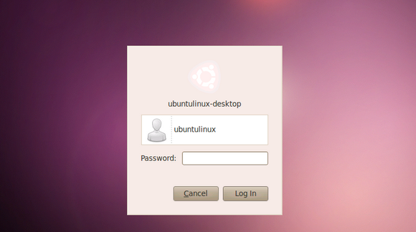
1. Login to Ubuntu
Type in the provided password for the user account, then press ‘Enter’ on the keyboard or left-click the arrow using the track pad.

Slide 7
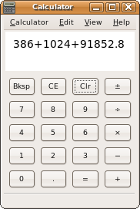
2. Open the Calculator
Click the ‘Dash Home’ button located at the very top of the “dock” on the left-side of the screen. In the search bar that appears, type “calculator”, and press ‘Enter’ or click on the ‘Calculator’ icon.

Slide 8
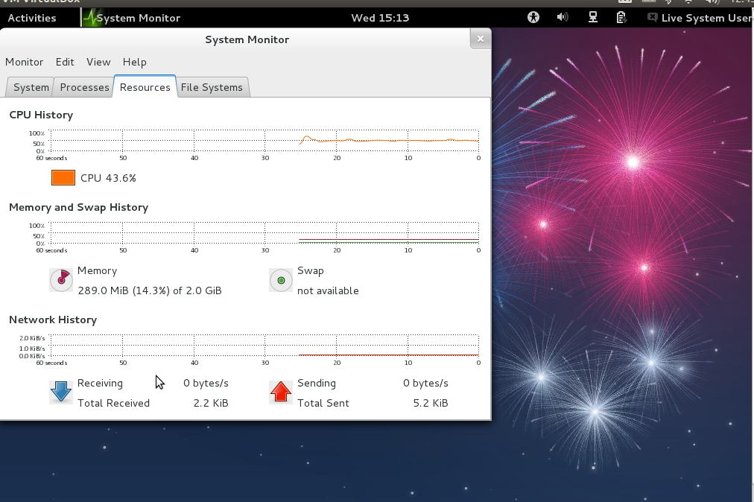
3. Find Out How Much RAM the Operating System Uses
Click the cog-wheel in the top right corner of the screen. Choose ‘System Settings’, in the drop down menu that appears. Under the ‘System’ section, choose ‘Details’. The amount of memory (RAM) will appear on the ‘Overview’ panel.

Slide 9
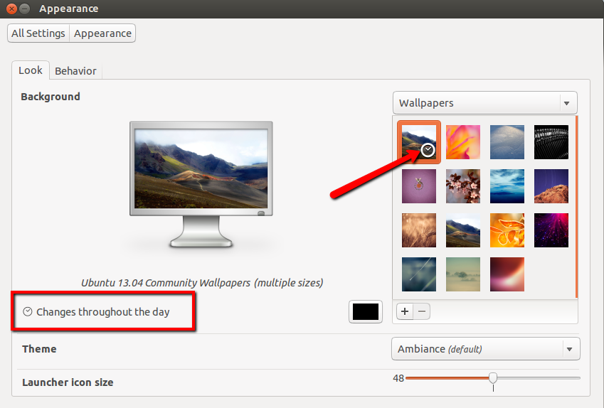
4. Change the Desktop Background
Right-click the desktop background. Choose ‘Change Desktop Background’ in the drop down menu. Choose one of the available wallpapers located in the preview section. Then close the window.

Slide 10
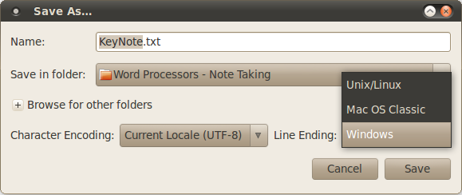
5. Create a .txt File and Save it in Documents
Click the ‘Dash Home’ button. In the search bar that appears, type “Text Editor” and hit ‘Enter’. Enter whatever text you would like here, then click ‘Save’. A ‘Save As’ window will appear. In the pane on the left, click ‘Documents’. In the top of the window in the ‘Name Box’, type “test.txt” then click ‘Save’.

Slide 11
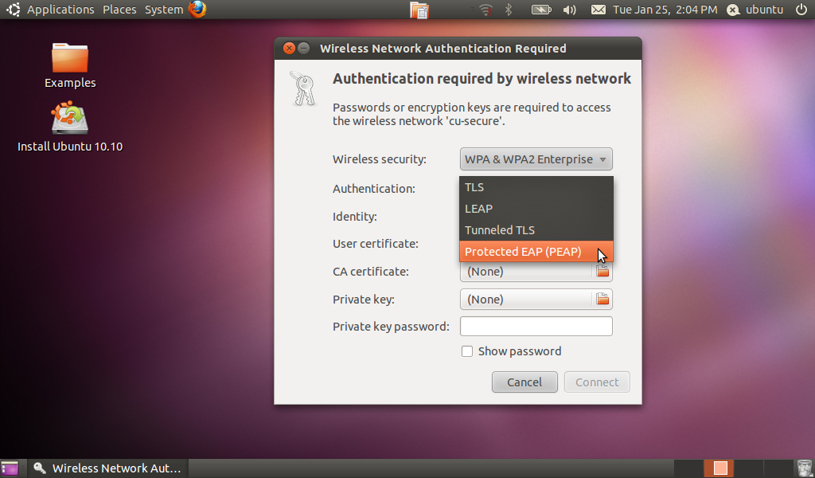
6. Connect to a Wireless Network
Click the ‘Wireless’ icon located at the top right of the screen. In the drop-down menu that appears, choose the specified wireless network and enter the provided credentials, if necessary.

Slide 12
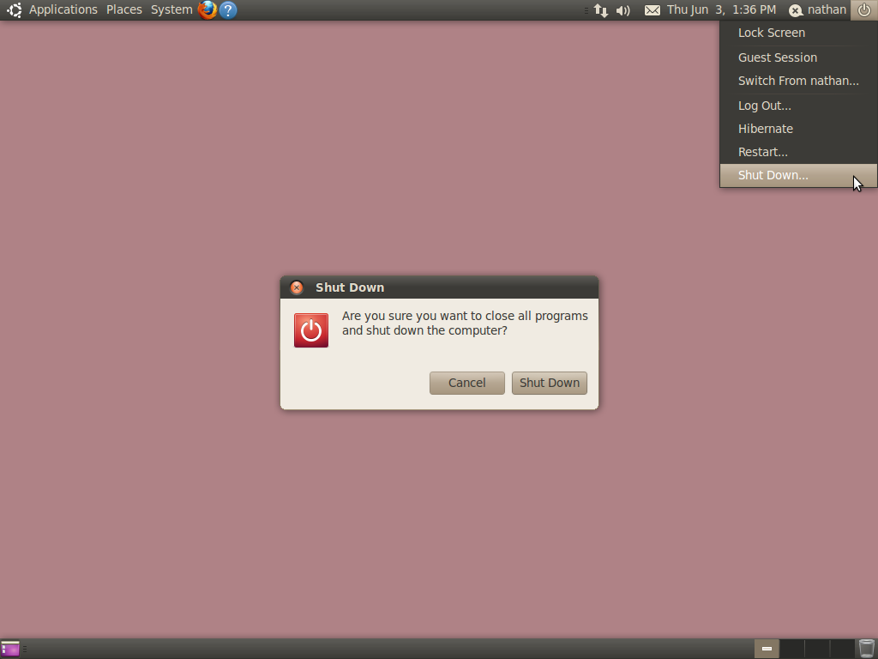
7. Shut Down the Computer
Click the cog-wheel icon located in the top-right corner of the screen. In the drop-down menu that appears, choose ‘Shut Down…’. In the window that appears, confirm the shut down procedure by clicking ‘Shut Down’.

Slide 13
Post-Testing Interview Questions
1. Do you feel that the written descriptions were helpful in accomplishing the tasks?
2. How did you feel about the order and level of difficulty in reference to the tasks?
3. Do you feel that the ‘Open Calculator’ task was a sensible starting point? Why?
4. What was your biggest obstacle when following the instruction (usability) manual?

Slide 14
Post-Testing Interview Questions Continued…
5. Did Ubuntu function as an efficient operating system?
6. How does Ubuntu compare to other operating systems you use in term of aesthetics?
7. Which task(s) do you feel were the most difficult?
8. How likely would you be to recommend Ubuntu to a friend or colleague?

Slide 15
Interface Usability Results
Name | Interface Usability Results
Emily Adams | The evaluator observed that Emily had a very easy time navigating around the Ubuntu interface and performing all of the required tasks.
Matthew Kidd | The evaluator observed that Matt had an extremely easy time navigating around the Ubuntu interface as well as performing all of the required tasks, which was to be expected, given his high level of computer literacy.

Slide 16
Interface Usability Results
Name | Interface Usability Results
Landon Canida | The evaluator observed that Landon performed every single task quickly and without any problems or confusion. Not surprising because, like Matthew, Landon has a high computer literacy level.
Jr. Paul | The evaluator observed that out of all of the participants, Jr. Paul was the one that had the most problems performing the specified tasks successfully. When taken in context, however, he still performed very well on the usability test, but just had more trouble doing it compared to everybody else.

Slide 17
Interface Usability Results
Name | Interface Usability Results
Jeff Cadet | The evaluator observed that overall Jeff did a good job in performing all of the specified tasks. He wasn’t the quickest at doing them, but he also wasn’t the slowest; he was average.

Slide 19
Conclusion
In the context of the parameters of this usability test, the only suggested improvement that can be made is to improve the labels.
Although some users indicated an average level of computer literacy, they were all able to perform the tasks nearly flawlessly. This fact acts as a testimony to the user-friendliness of the Ubuntu operating system.
Given the results of the usability test, the usability of the Ubuntu operating system is very good.

