Slide 1
A note about Loss Functions

Slide 2
Detour to talk about Entropy
Claude Shannon (1948) studied the size of information in a transmitted message (source: Wiki – Entropy).
Discussed Entropy as the measure of the amount of missing information before reception of the message.
Consider a system with only two possible messages. If they are (both) equally probable, then the Entropy is given by:
H(X) = - ( p(x1) log p(x1) + p(x2) log p(x2) )

Slide 3
Detour to talk about Entropy
Given that they are equiprobable:
H(X) = - ( p(x1) log p(x1) + p(x2) log p(x2) )
= - ( (0.5) Log₂ (.5) + (0.5) Log₂ (.5) )
= - ( (0.5) ( -1) + (0.5) (-1) )
= 1
This says that Entropy is maxed out (at 1) when outcomes are equally likely.

Slide 4
Detour to talk about Entropy
Consider the case where ONLY x1 (or could have said only x2) happens.
H(X) = - ( p(x1) log p(x1) + p (x2) log p(x2) )
= - ( (1) Log₂ (1) + (0.0) Log₂ (.0) )
= - ( (1) ( 0) + 0 )
= 0
This says that Entropy is zero when the outcome is fully predictable.
If x1 were 90 percent likely, and x2 were 10 percent likely, entropy is low.

Slide 5
Detour to talk about Entropy
So, Entropy is a measure of how unpredictable the situation is.
The more unpredictability means more information is contained in the next data item.
Now, we will proceed to discuss Loss Functions.

Slide 6
Loss Functions
The job of the Loss Function is to represent the whole NN computation with a single number, such that as the number gets smaller, we can be confident that the NN is doing its job and succeeding at its task.
Most of the time, in Classification or Detection problems, the task of the NN is simply to mimic the target “ground truth” information. This means that in the ultimate step of the computation (output layer), the result should be very close to what the training signal or target ground truth was.
We saw in the Simple NN that the way that that was achieved was to simply subtract the result from the target, square that gap quantity (the answer from the subtraction) and then take half of it.

Slide 7
Loss Functions
The approach in the previous Simple NN is a version of the Mean Squared Error loss. This has been a very popular Loss Function employed due to its conceptual simplicity.
A more modern Loss Function is the Binary Cross Entropy loss that appears to speed up the convergence of the NN for binary Classification problems or simple Detection problems.
The idea behind the BCEL is to have it judge whether the “distribution” of the target set has been mimicked sufficiently correctly by the NN. Hence, the two distributions need to be compared.

Slide 8
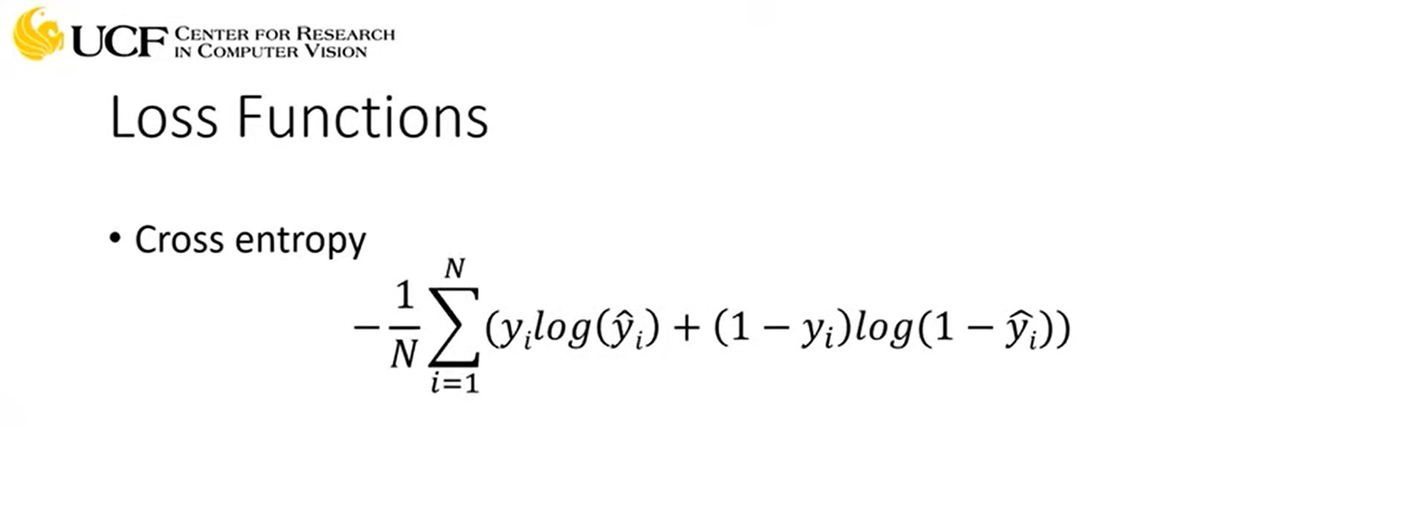
Loss Functions
Given N samples of data, and yᵢ as the targets with ŷᵢ as the NN’s results, then the BCEL is:
a

Slide 9
The Binary Cross Entropy Loss
Let us examine the BCEL.
Because we have a binary classifier, we will assume that if Class 1 is present, then the value of yᵢ is one, and (1 - yᵢ) is zero; when Class 1 is absent, the yᵢ is zero and (1 - yᵢ) is now one.
When Class 1 is present, the expression simplifies to negative log of the NN’s result. If the NN’s result is close to 1, this leads to a low positive value from the negative log, which is how it should be.
If the NN’s result is close to zero (in disagreement with the target), this will lead to a high positive value., which is correct behavior, in keeping with the disagreement.
When Class 1 is absent, the expression simplifies to negative log of 1 minus the NN’s result. When the NN’s result is low (in agreement with the target), then 1 minus this value will be close to 1, resulting in a low penalty score. If the NN’s result is close to 1 (disagreeing with the target), 1 minus this value will be small, resulting in a large penalty.
Note: in this discussion, the NN’s result is ŷᵢ

